Slide 1
بِسْمِ اللهِ الرَّحْمٰنِ الرَّحِيْمِ

Slide 2
DESIGN OF MACHINES
PRESENTATION
ZIP LINE PULLY MECHANISM
Department of Mechatronics & Biomedical Engineering, Air University, Pakistan

Slide 3
PRESENTED BY:
FATIMA NAZIR (201901)
SYED QAMAR ABBAS (201151)
MOEEZ SAQIB (201178)
SUPERVISED BY:
Dr. IMRAN SHAH
Department of Mechatronics & Biomedical Engineering, Air University, Pakistan

Slide 4

INTRODUCTION ZIP LINE PULLY MECHANISM
We have to design the zip line pulley mechanism in terms of applied shear force, engineering principles like Von Mises theory can be applied to ensure the pulley's material can withstand the stresses induced by the forces acting on it.
Von Mises theory is often used in materials science and engineering to predict yielding of materials under combined loading conditions. In the case of a zip line pulley, the forces acting on the pulley, such as the weight of the rider, friction, and dynamic forces during acceleration and deceleration, create shear stress on the pulley's material.
Department of Mechatronics & Biomedical Engineering, Air University, Pakistan

Slide 5
LITERATURE REVIEW
The zip line pulley mechanism is specifically designed for the smooth movement of riders along the cable in a zip line setup. Functionality The pulley is the central component that traverses the cable, allowing riders to move from a higher to a lower point using gravity[1].
It's engineered for minimal friction and smooth gliding. Design Typically made of durable materials like steel or aluminum, the pulley incorporates bearings or rollers to reduce friction and ensure efficient movement along the cable.
Department of Mechatronics & Biomedical Engineering, Air University, Pakistan

Slide 6
PROBLEM STATEMENT:
We have to design the zip line pulley mechanism in terms of applied shear force, engineering principles like Von Mises theory can be applied to ensure the pulley's material can withstand the stresses induced by the forces acting on it.
Department of Mechatronics & Biomedical Engineering, Air University, Pakistan

Slide 7
PROJECT OBJECTIVE:
Performing stress analysis and Von Mises calculations for a zip line mechanism involves evaluating the structural integrity of the components under different loads and conditions. Here's a step-by-step guide to conduct this analysis.

Slide 8
SCOPE:
The main scope in our daily life The scope of zip-lines around the world varies widely, from simple backyard zip-lines which are designed to be safe enough for children to very high, long professional ziplines used in locations where other methods of transport are not practical.

Slide 9
METHODOLOGY
The zip line pulley mechanism is specifically designed for the smooth movement of riders along the cable in a zip line setup.
Functionality:
The pulley is the central component that traverses the cable, allowing riders to move from a higher to a lower point using gravity. It's engineered for minimal friction and smooth gliding.
Design:
Typically made of durable materials like steel or aluminum, the pulley incorporates bearings or rollers to reduce friction and ensure efficient movement along the cable.
Operation:
The operation of a pulley mechanism on a zip line is:
The pulley mechanism is securely attached to the zip line cable, typically through a harness or a direct connection..
Braking mechanisms, controlled by the rider or an automated system, regulate speed and ensure a safe, controlled descent.
Department of Mechatronics & Biomedical Engineering, Air University, Pakistan

Slide 10
PRODUCT SPECIFICATIONS:
Total area of plate= 907.35cm²
Total volume of plate=426.3cm³.
Weight of plate= 4.325 kg
Weight of pulley= 0.590 kg
Density of mild steel=7860kg/m³
Department of Mechatronics & Biomedical Engineering, Air University, Pakistan

Slide 11

CALCULATION:
  Data:
S_{ut} = 4x10⁸ N/m²
S_{yt} = 2.5x10⁸ N/m²
F= 1000 N
Diameter of notch=d = 2 cm
Width=w= 80 cm
$\frac{d}{w}$ = 0.02
$\frac{d}{h}$ = 4 (h denote the thickness)
Find $σ_{m}$
$σ$ = $\frac{My}{I}$ (where I = $\frac{1}{12}$ bh³) (1)
Now putting the value on the l, M and y then find the value of $σ_{m}$
I = $\frac{1}{12}$ (w-d) x h³ (2)
I= 8.125 x 10⁻⁹ m⁴ (3)
y_{max =} $\frac{h}{2}$ (4)
Department of Mechatronics & Biomedical Engineering, Air University, Pakistan

Slide 12
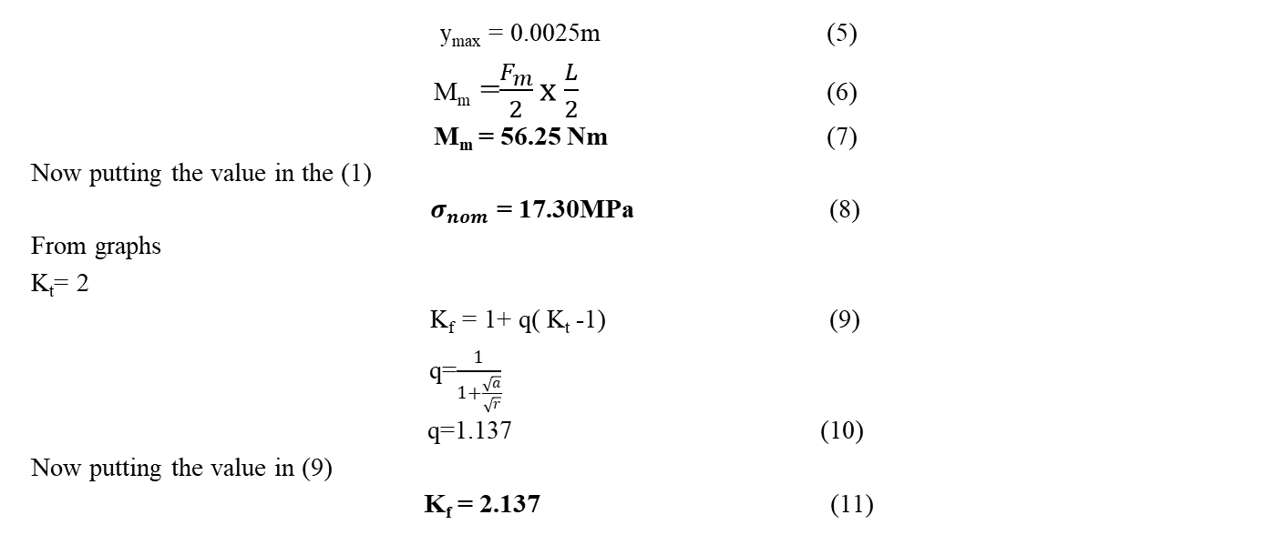
CALCULATION:
y_{max} = 0.0025m (5)
M_{m} =$\frac{F_{m}}{2}x$ $\frac{L}{2}$ (6)
M_{m} = 56.25 Nm (7)
Now putting the value in the (1)
$σ_{nom}$ = 17.30MPa (8)
From graphs
K_{t}= 2
K_{f} = 1+ q( K_{t} -1) (9)
q=$\frac{1}{1+\frac{\sqrt{a}}{\sqrt{r}}}$
q=1.137 (10)
Now putting the value in (9)
K_{f} = 2.137 (11)
Department of Mechatronics & Biomedical Engineering, Air University, Pakistan

Slide 13

CALCULATION:
As we know the
$σ$ =K_{f}$σ_{nom}$
$σ$= 3.6797 MPa (12)
Now according to the grid mesh independence table we selected the
$σ$_{sim} = 3.9 MPa (13)
Now find the error by using the %error
%Error = $\frac{3.9−3.6}{3.9}$ x 100
%Error = 5.20%
Department of Mechatronics & Biomedical Engineering, Air University, Pakistan

Slide 14
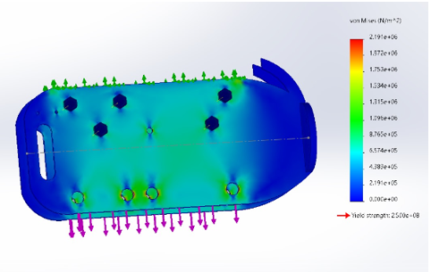
CAD MODELLING:
Simulation of Stresses Analysis:
Department of Mechatronics & Biomedical Engineering, Air University, Pakistan

Slide 15
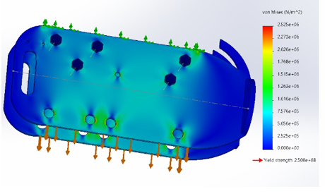
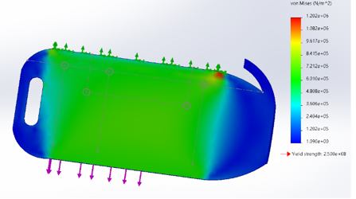
CAD MODELLING:
Von Mises Stresses with and Without Notches Simulation:
Department of Mechatronics & Biomedical Engineering, Air University, Pakistan

Slide 16
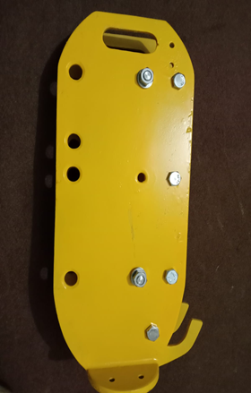
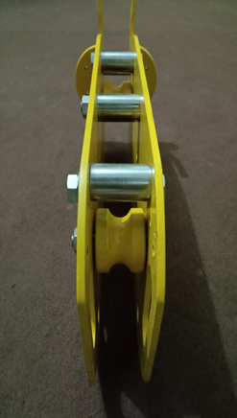
HARDWARE SETUP:
Department of Mechatronics & Biomedical Engineering, Air University, Pakistan

Slide 17
THANK YOU
Department of Mechatronics & Biomedical Engineering, Air University, Pakistan

